Slide 1
PRESENTATION
Shahzadi Erum
Digital Marketing Internship
13-April-2026

Slide 2


CAMPAIGN OVERVIEW
Chic Diary
Chic Diary is a digital fashion accessory brand
Offers scrunchies, charms, and bracelets
Focus on affordable and aesthetic products
Campaign goal: increase awareness, engagement, and sales

Slide 3
TARGET AUDIENCE
Age group: 15–30 years
Active social media users
Interested in fashion and trendy accessories
Prefer affordable and aesthetic products

Slide 4
COMPETITOR ANALYSIS
Key competitors: Scrunchiedotcom, charms_by_neha, etc.
Active on Instagram, Facebook, TikTok
Focus on trendy products but often higher prices
Chic Diary advantage: affordable + trendy bundles

Slide 5
MARKETING CHANNELS
Instagram – reels & posts
Facebook – ads & promotions
TikTok – viral content
Google Ads – paid reach
YouTube – tutorials & shorts
Pinterest – inspiration

Slide 6
Reach 1,000–3,000 users
Increase engagement by 20–25%
Gain 100–200 followers
Generate 150–200 clicks
Drive 80–150 potential customers
CAMPAIGN GOALS (SMART)

Slide 7
CONTENT STRATEGY
Social posts: reels, carousels, flatlays, Static post
Blog: styling tips
Email: promotional campaign
Ads: bundle offers & urgency-based content

Slide 8
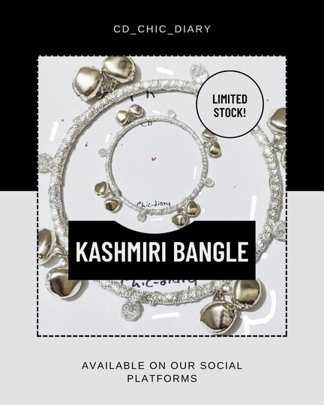
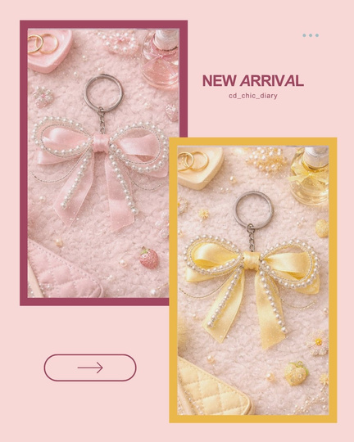
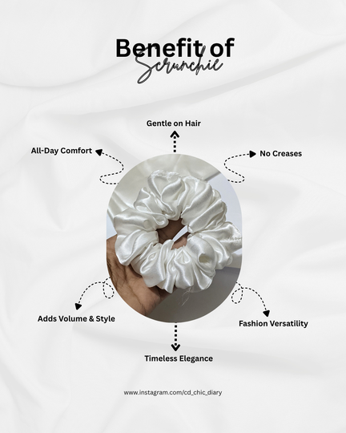
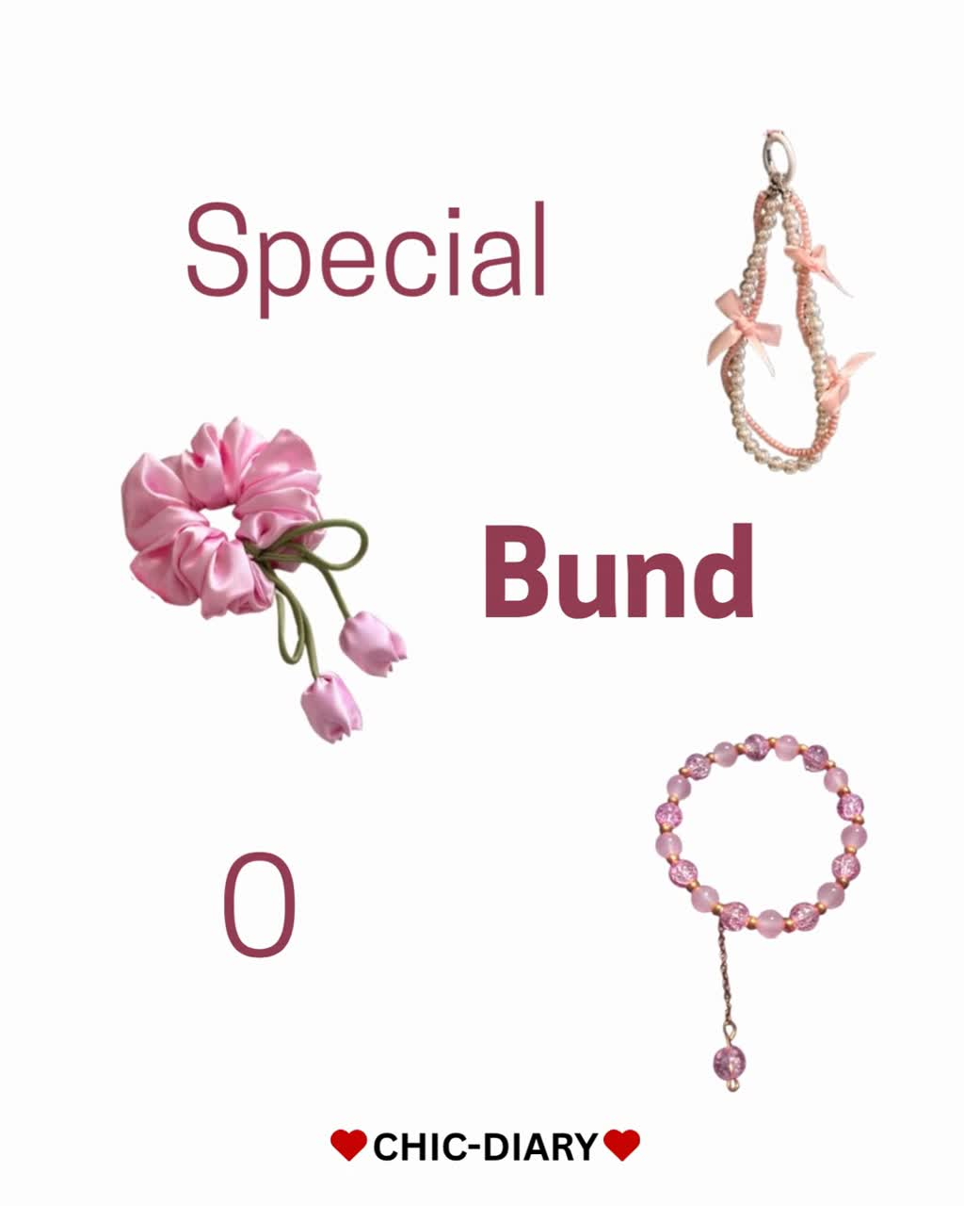
CONTENT SAMPLES
Video’s link: https://www.instagram.com/p/DWosgzjDc8u/

Slide 9
PERFORMANCE ANALYSIS (MOCK RESULTS)
Reach: 4,200 users
Engagement: +22% increase
Followers: +150 gained
Clicks: 180
Orders/Inquiries: 90+

Slide 10
INSIGHT
Reels performed best
Bundle deals increased conversions
Aesthetic visuals boosted engagement

Slide 11
RECOMMENDATION
Focus on short-form content
Collaborate with influencers
Introduce limited offers
Maintain affordable pricing

Slide 12
THANK YOU

